Slide 1


Sentiment Analysis with Social Media Data
AIDI 1003 – Capstone
Tejas Vyas
Riddhi Thakkar
Gbemisola Banjoko
Manu Sihag

Slide 2
Problem Statement
Social networks today have allowed businesses and brands to connect to millions of people, but have issues gathering user attitude towards brands/products due to the huge scale
Computers while assisting brands using rule-based or keyword extraction, have issues with analysis due to limited accuracy of classification
Sentiment Analysis through machine learning can help in avoiding misclassification and assist users in easily researching user perception and insights on products

Slide 3
Project Idea
Create a web application that allows user to enter a brand or product name
We then use social media data (tweets, IG/FB/Reddit posts, yelp/google/amazon reviews) ran through a classifier to return whether the opinion of users towards the search term is positive, neutral or negative during the time period.

Slide 4
Existing work / Rationale
Very few products offer this service, but are expensive for small businesses at scale
https://blog.hubspot.com/service/sentiment-analysis-tools
For a consumer example, Steam, a game marketplace allows users to view user sentiment towards the game.
Our dashboard would be free (cheap for live data), allowing easy lookup for a timespan across social media platforms
Papers doing this but no accessible products:
From Group to Individual Labels Using Deep Features: https://dl.acm.org/doi/10.1145/2783258.2783380
Analyzing users’ sentiment towards popular consumer industries and brands on Twitter: https://arxiv.org/pdf/1709.07434.pdf

Slide 5
Datasets
Kaggle:
Labelled reviews: https://www.kaggle.com/marklvl/sentiment-labelled-sentences-data-set
Amazon Reviews
Yelp Reviews
IMDb Reviews
For each website, there exist 500 positive and 500 negative sentences.

Slide 6
Approach - Classification
Project has 2 components:
Classifier (ML model)
We tried 6 different algorithms approaches:
Logistic Regression, Naïve Bayes, Support Vector Machines, Decision Tree, Random Forest, Deep Learning (LSTM)
For Feature generation through Vectorization, we compared 2 techniques:
Count Vectorizers with n-grams(1-3), Tfidf Vectorizer
Our final candidate came out to be Support Vector Machine with an accuracy of 83% using Tfidf Vectorizer
This was saved as a joblib file to use on working website

Slide 7
Approach – Web app
Web Application
We used Flask to create a web application:
Back-end: Python using model.joblib
Front-end: HTML5/CSS3/JS/Flask
The webservice is hosted on Azure
Accessible at: https://reviewsentimentanalyzer.azurewebsites.net//
Linked to live Twitter data where users can type a topic and view consensus based on recent 50 tweets
Neutral = Equal Negative + Equal Positive
Generally Positive = Positive > Negative
Generally Negative = Positive < Negative
Overwhelmingly Positive = > 50% Positive
Overwhelmingly Negative = > 50% Negative

Slide 8
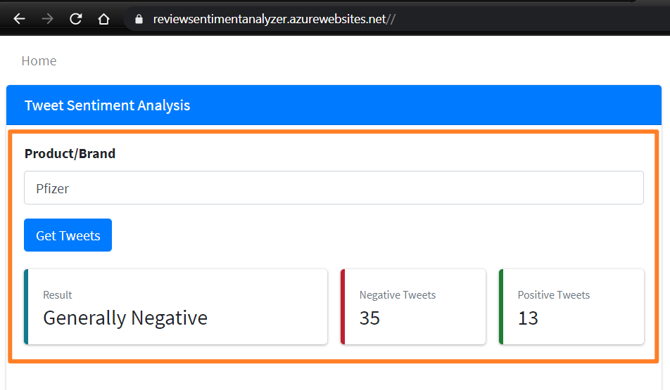
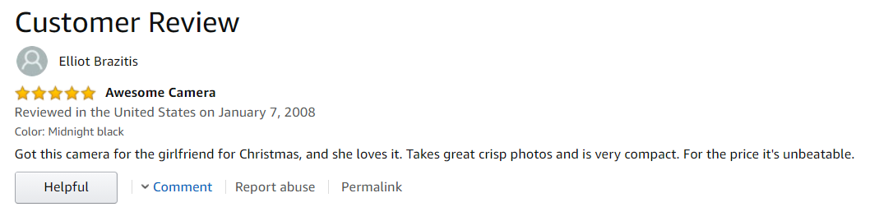
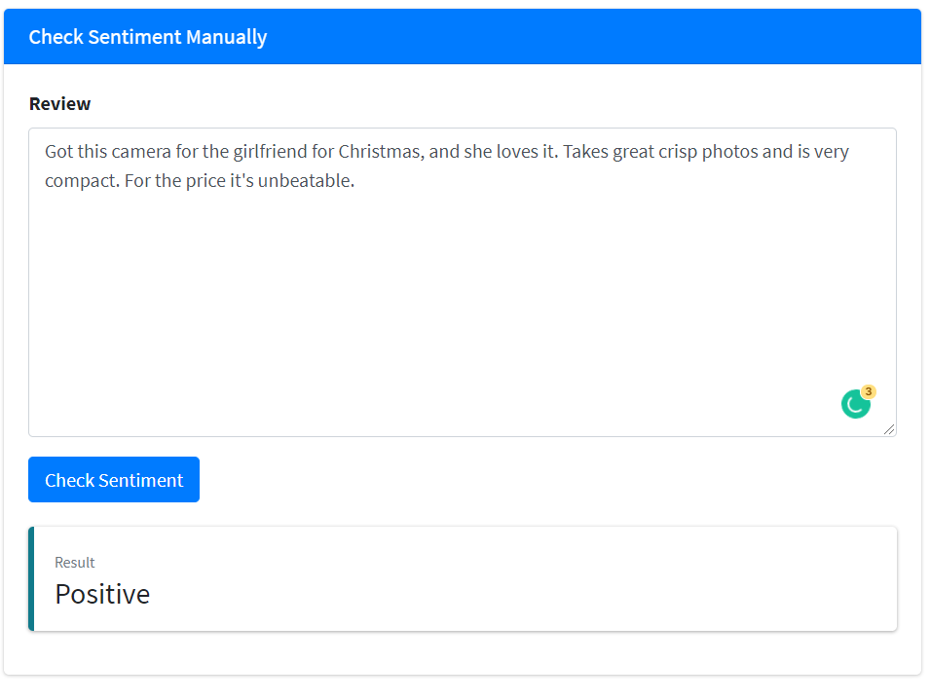
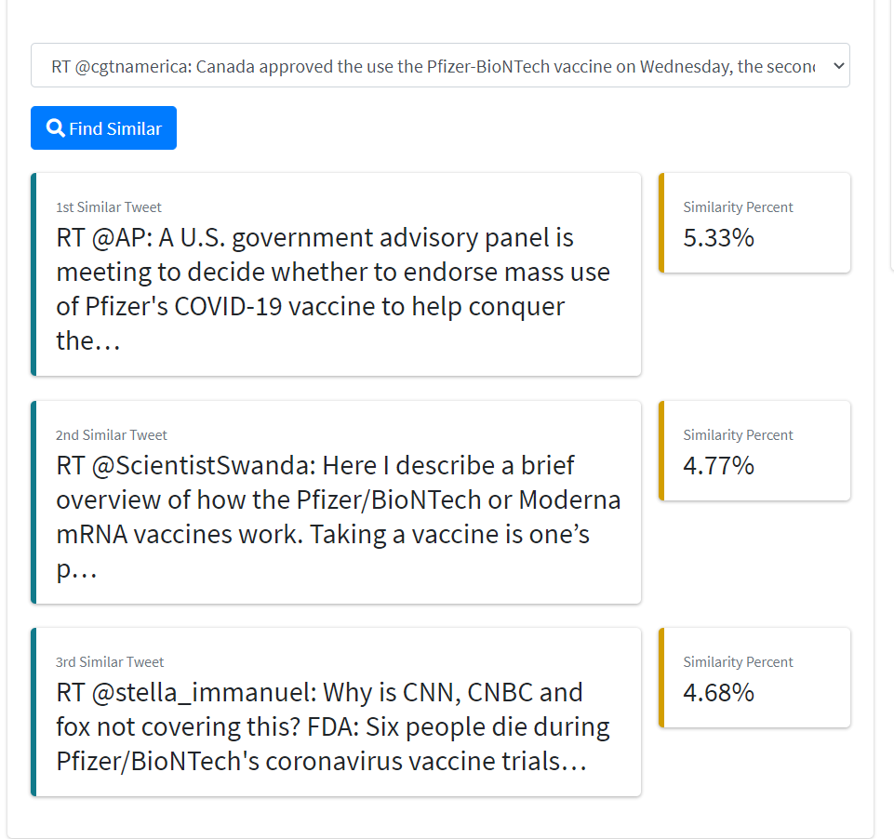
Additional Features
Web Application also allows users to see similar tweets
Web Application allows users to paste any text and see the sentiment

Slide 9
Future Development
Allow website to keep cache and history
Add Support for different social media and review sites
Retrain ML model to use more data from social media websites like Twitter and Facebook
Incorporate Deep Learning again when significant data is available
Currently, the accuracy for this technique is less than SVM because of limited dataset, and the text encoder used

